Slide 1
Classifying Reddit Posts: A Graph Neural Network Approach
Amir 224030 • Merihan 226392 • Omar 228248 • Sameh 218767

Slide 2
Table of contents
01
02
03
04
05
06
Introduction
Data
Preprocessing
Data Representation
Methodology
Training and Testing
Key
Findings

Slide 3
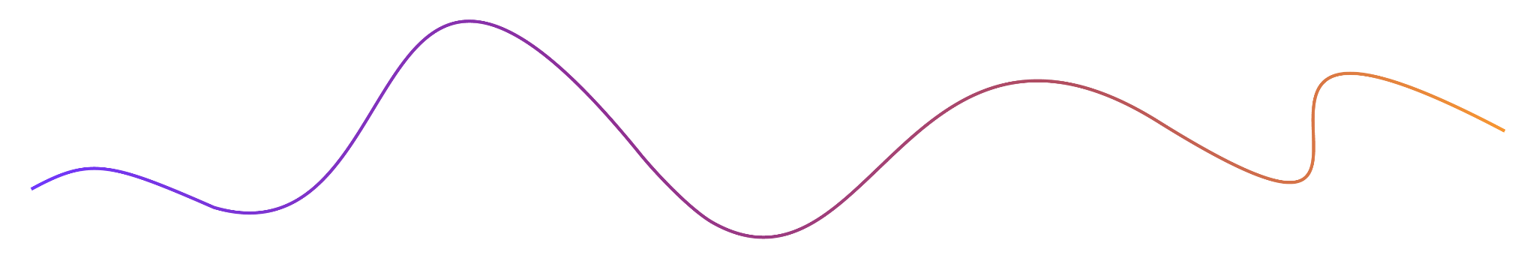
01
Introduction

Slide 4
Introduction
Goal
Dataset
Evaluate Graph Neural Network (GNN) models for subreddit classification.
Reddit dataset of posts from (2006–2016) with 3,848,330 posts.
Features
GNNs
Includes a number of features related to the post most notable and used ones were content, author, and subreddit.
Evaluated four different GNNs including GraphSAGE, GatedGNN, GIN, GCN.

Slide 5
02
Data Preprocessing

Slide 6
Data Preprocessing
Select Relevant Features
Clean text from special characters, stop words, etc.
Embed text into vectors
Encode subreddits, authors into numbers.
Drop irrelevant features

Slide 7
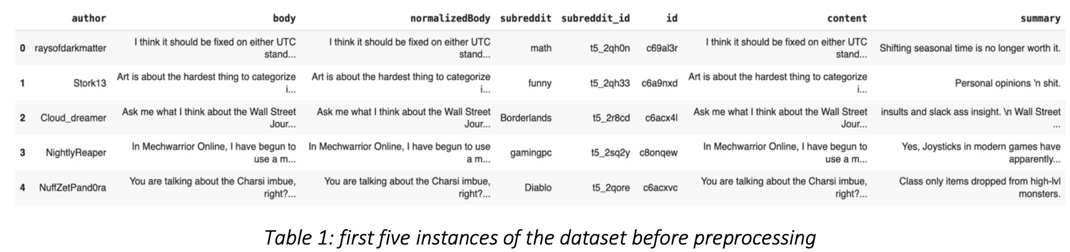
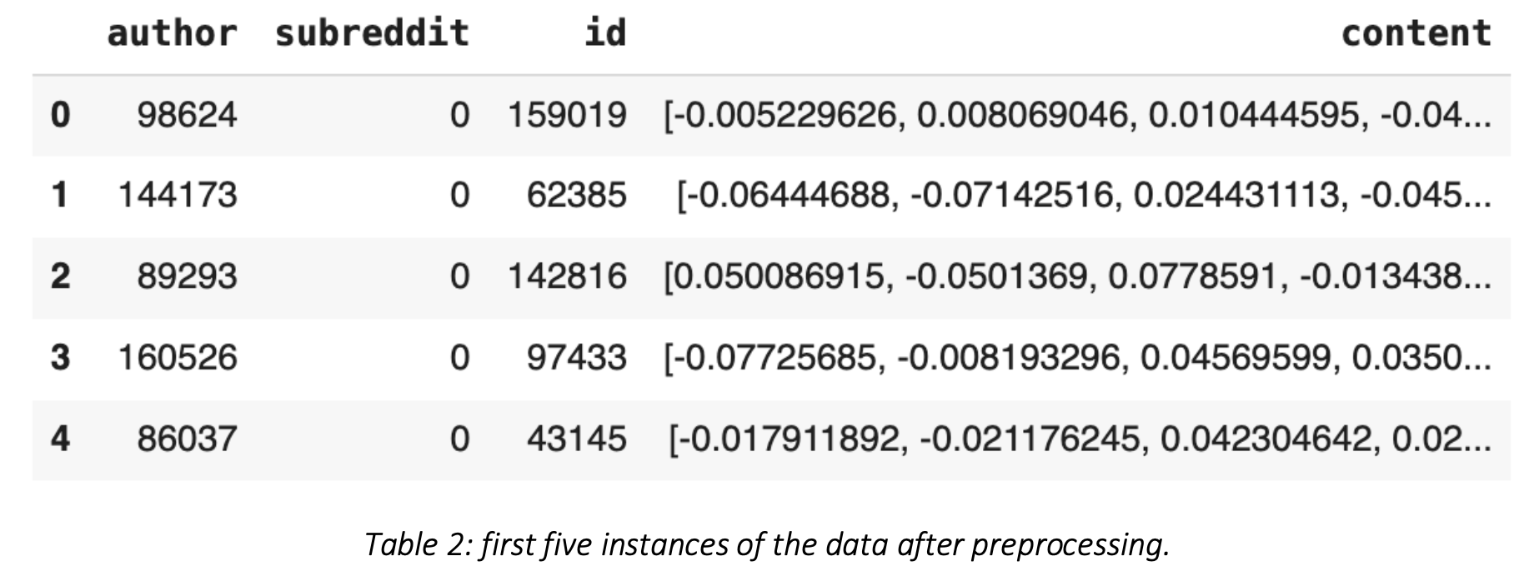
Data Preprocessing

Slide 8
03
Data Representation

Slide 9
Data Representation
Heterogenous graph
Posts and authors represent nodes
Unweighted ownership edges between authors and posts
Weighted edges between posts representing similarity
P1
P2
0.86
P3
A2
A1

Slide 10
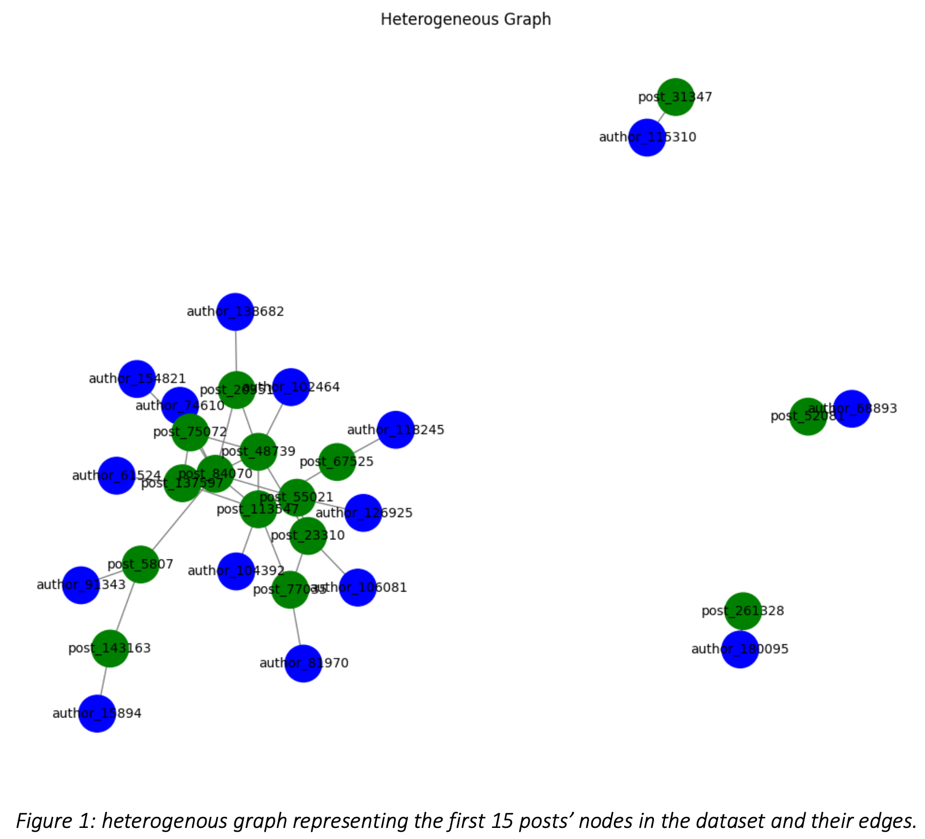

Slide 11
04
Methodology

Slide 12
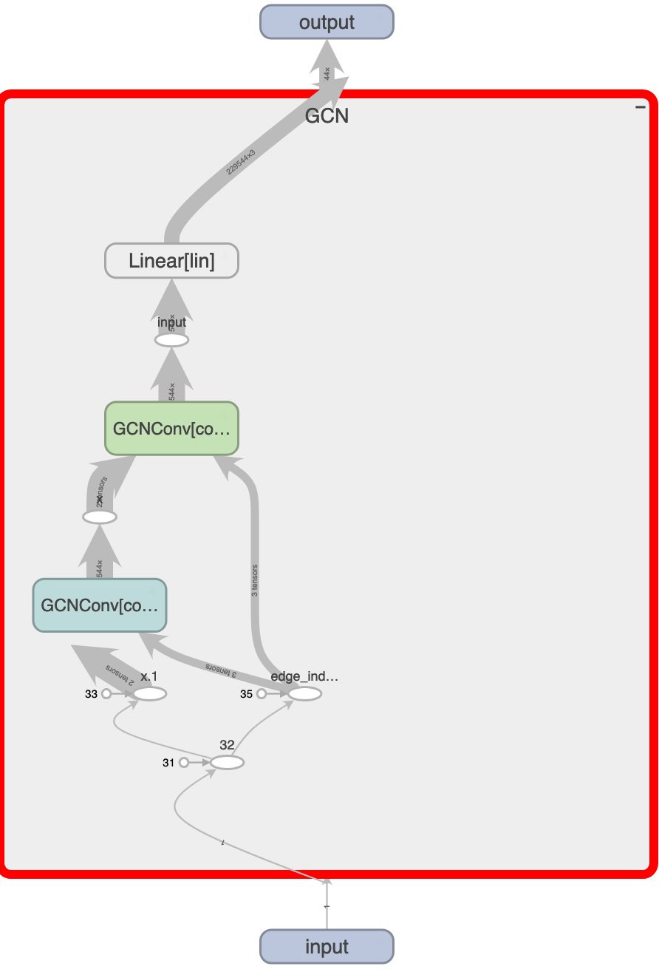
Design and Architecture
Models Compared
We trained and evaluated four models which are GraphSAGE, GatedGNN, GIN, and GCN.
Models’ Design
Each model has a corresponding two convolutional layers followed by two ReLU layers and a final linear layer.

Slide 13
05
Training and Testing

Slide 14
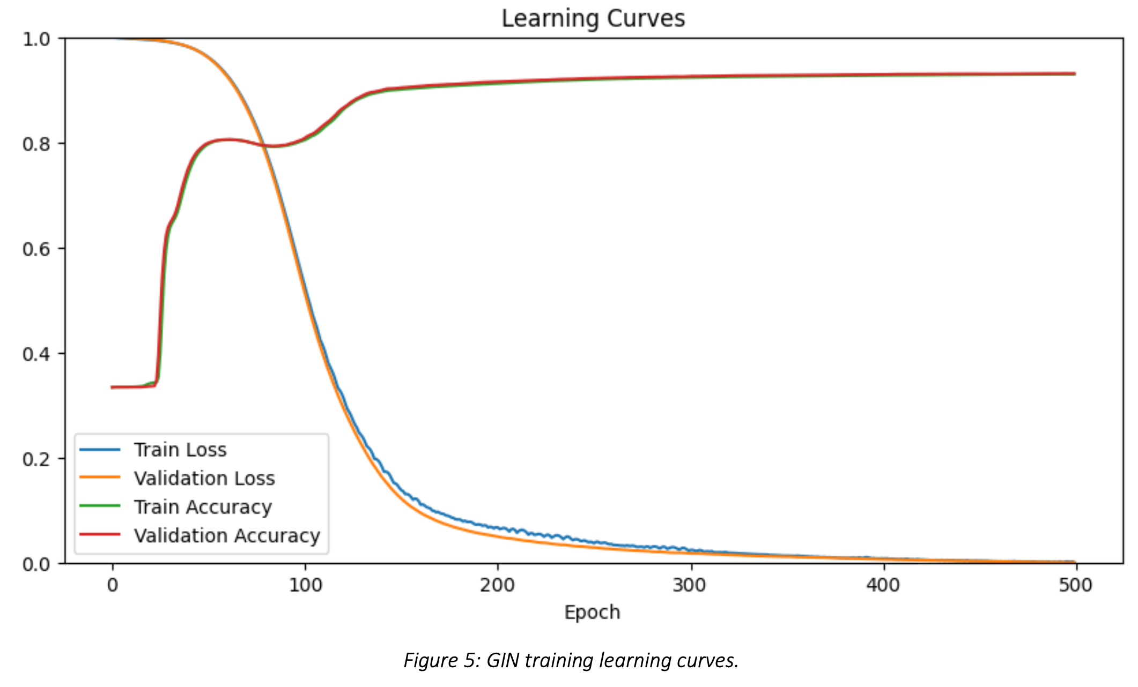
Training the Models
Each model was trained for 500 epochs
ADAM used as an optimizer
Cross entropy loss used as cost function
Unified mean aggregation function

Slide 15
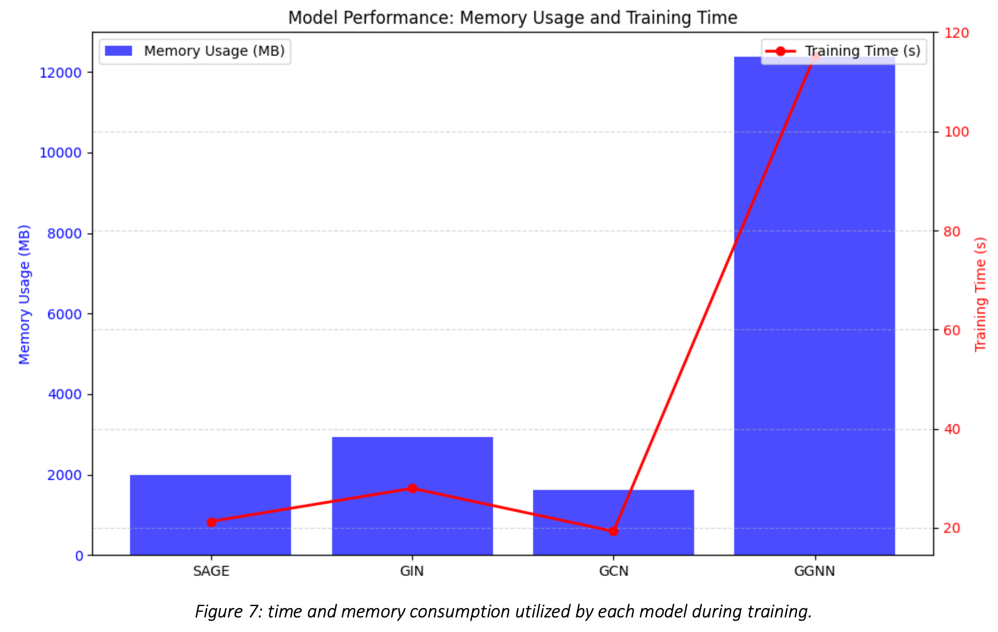
Training the Models

Slide 16
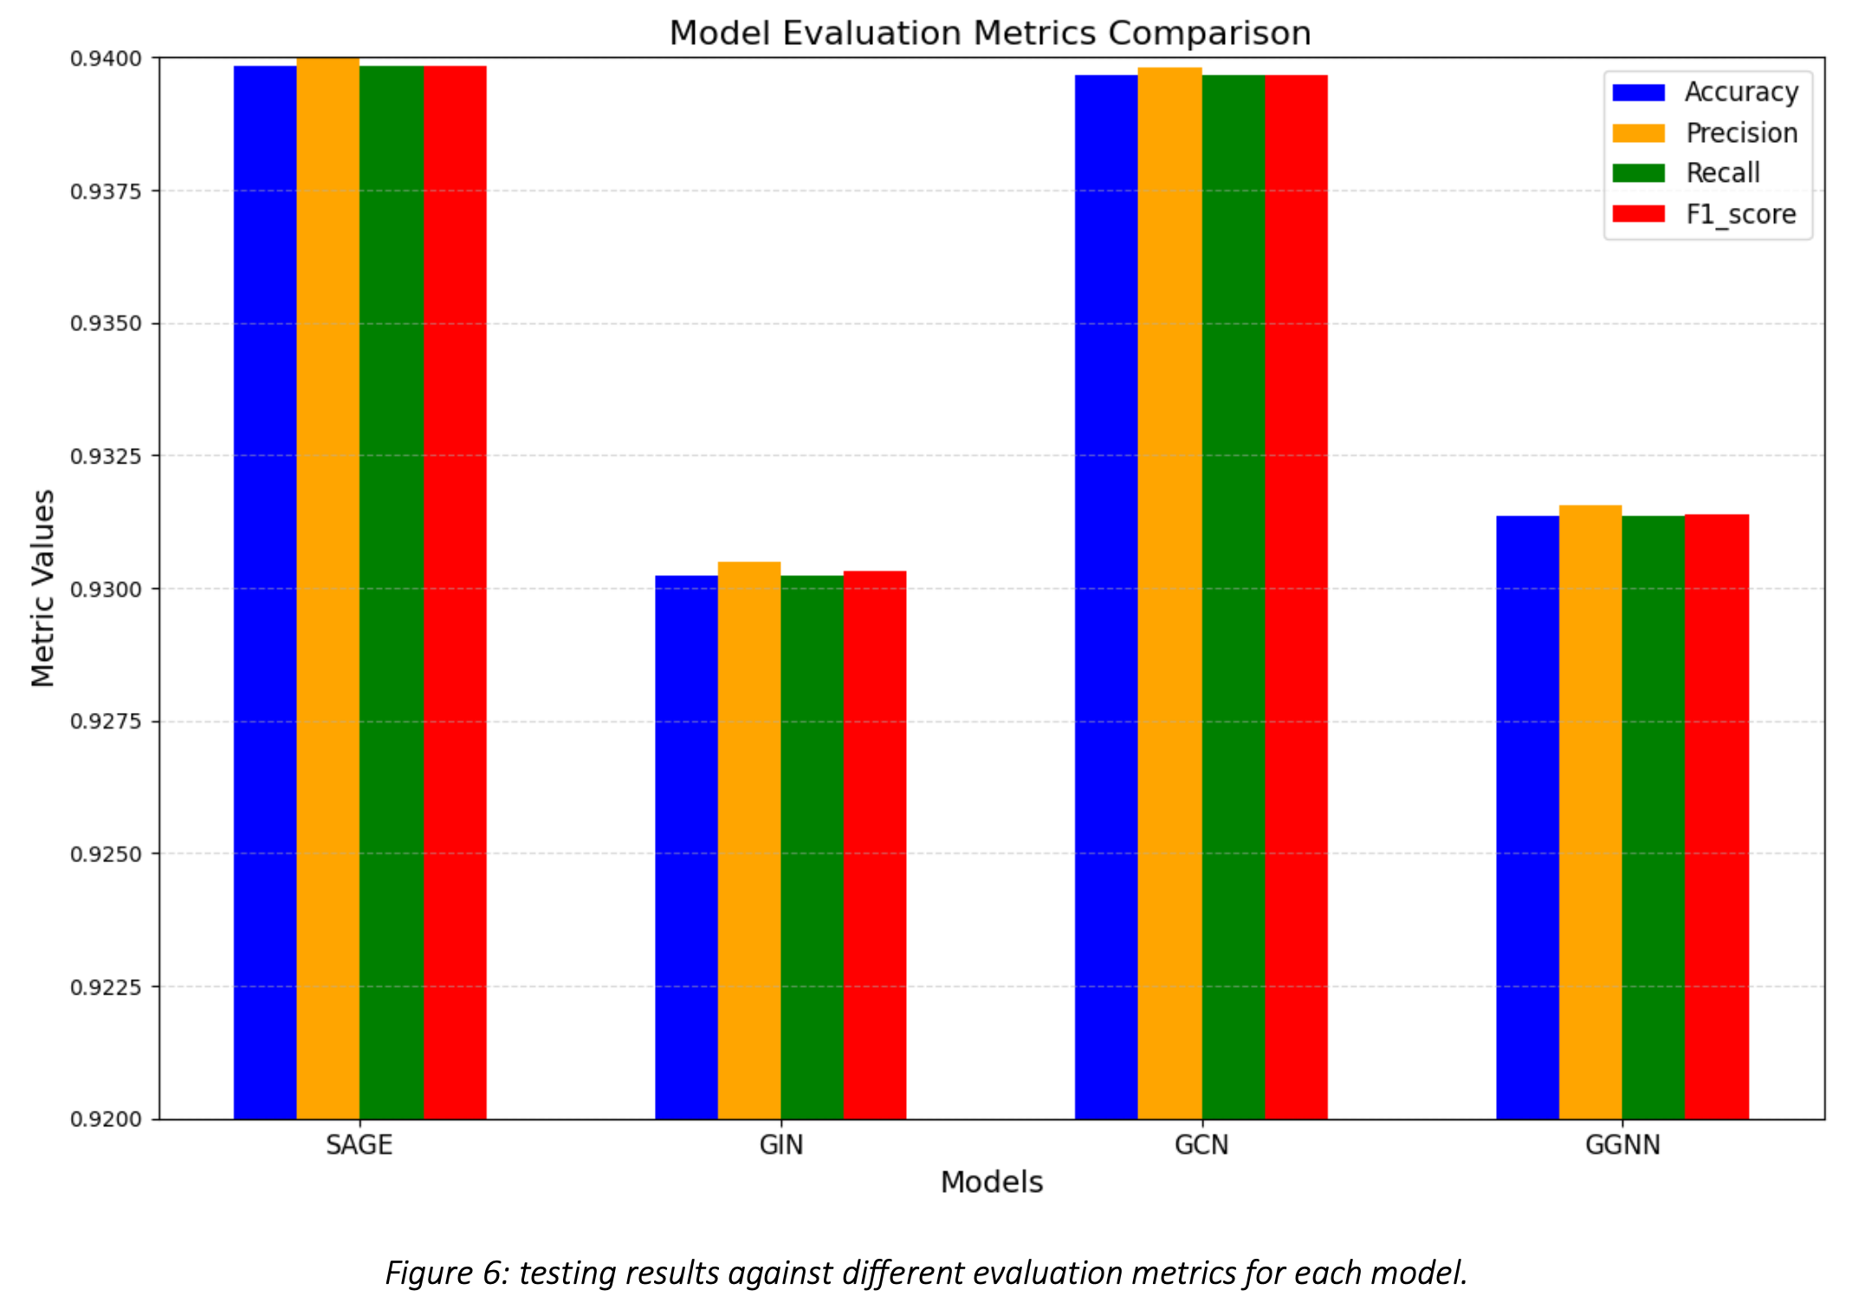
Performance on Test Set

Slide 17
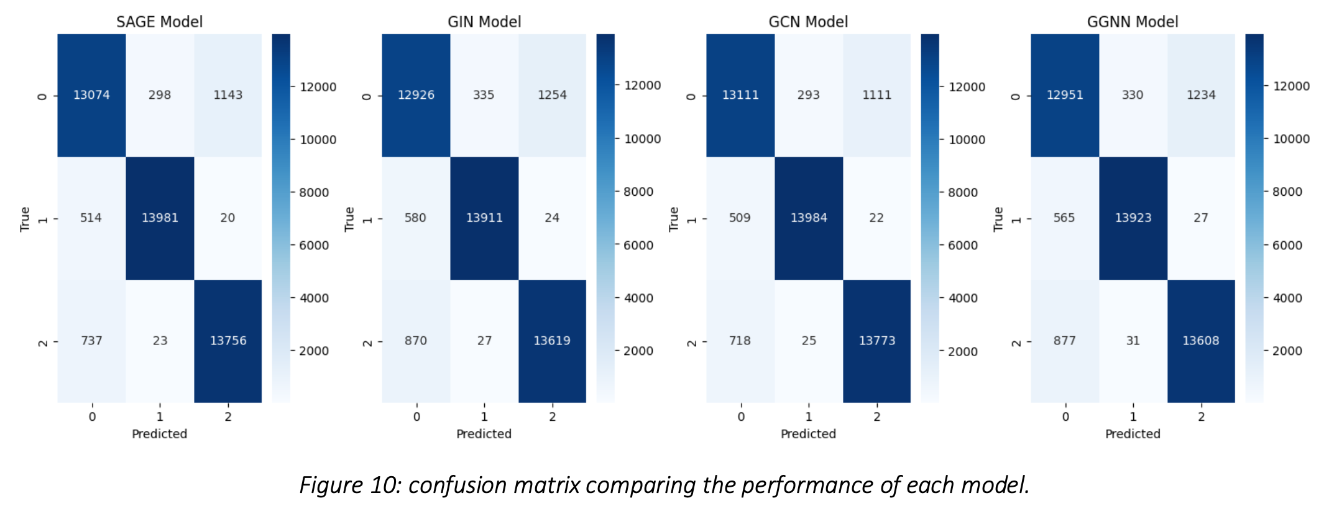
Performance on Test Set

Slide 18
06
Key Findings

Slide 19
Performance Under different Hyperparameters
Evaluated the four models with different hyperparameters
Each model were trained to 100 epochs
Different aggregation functions and out channels evaluated for GraphSAGE
Different out channels for GCN
Different values for epsilon for GIN
Different values for number of layers, out channels, and aggregation function for GatedGNN

Slide 20
Key Findings
Model | Results | Reason
GraphSAGE | Max aggregation function and lower values of out channels yield better performance | Max function captures most dominate features reducing noise, and lower out channels are less prone to overfitting and less sensitive
GatedGNN | Lower number of layers, max function, and higher values of out channels yield better performance (but takes so much time to train) | Max function capture important features, high number of layers prone to overfitting, gradient banishing, smoothing, and high values of out channels can capture complex patterns
GCN | High values of out channels tend to produce better performancee but the learning curve abruptly fluctuate across epochs | High values can capture complex pattern but are more prone to overfitting and sensitive to noise
GIN | Different values of epsilon do not seem to have any noticeable change in performance. However, a slight fluctuation in learning curve can be observed in the very early and last epochs. | High values of epsilon amplify the gradients associated with each node’s features, hence, can lead to significant weight updates causing fluctuation

Slide 21
Best Model for the Task
Overall, GCN strikes the best balance between performance, simplicity, and efficient resource utilization. GraphSAGE follows in the second place, GIN in the third, and finally GatedGNN which has quite similar performance to GIN but the intense resource usage is unjustifiable for this task.

Slide 22
Thanks!
Please keep this slide for attribution

